Slide 1
Chinese New Year

Slide 2
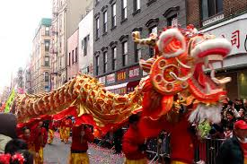
Chinese new year
A celebration of the new year (however this falls on a different day each year as the Chinese follow a lunar calendar (which follows the moon). Chinese New year normally falls Jan-Feb and the festivities last for 15 days. Chinese new year is an important annual festival celebrated by Chinese people all around the world for over 5000 years It marks the first day of the new year. It signifies the ned of winter and the beginning of spring, the sweeping away of misfortunes and the welcoming of the new year with gifts and symbols of luck.

Slide 3
https://www.youtube.com/watch?v=guwPTBmuiN8

Slide 4
Paper Dragon
The paper dragon is carried by as many as 40 people in a street parade to the sound of drumming, symbols, firecrackers and music.
Fire crackers are thrown at the lion’s feet to scare away evil spirits.
The lion is believed to bring good fortune and ward off evil spirits.

Slide 5
Loin Dance

Slide 6
Fortune Cookies
Are boiled dumplings
Called Po-po
Made from white flour with special messages inside
These are eaten and are simple expressions of wishes of good fortune for the coming year

Slide 7
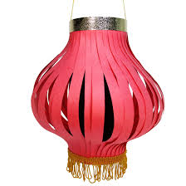
Chinese paper lanterns
Villagers would hang red lanterns and red cut-outs on windows and doors.
This was to scare away the mythical beast called the Nian.
The Nian would eat livestock, crops, villagers and especially children

Slide 8
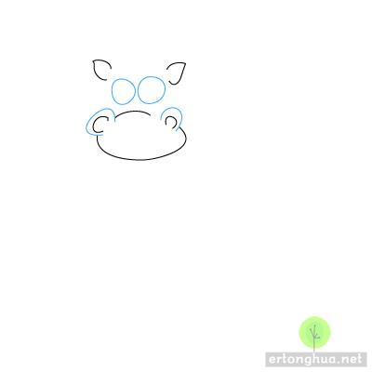
Draw a Dragon 1

Slide 9
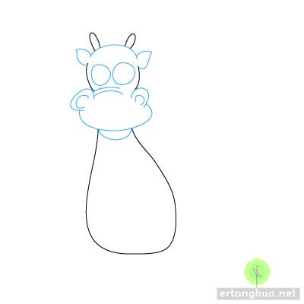
Draw a Dragon 2

Slide 10
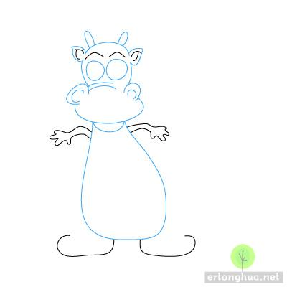
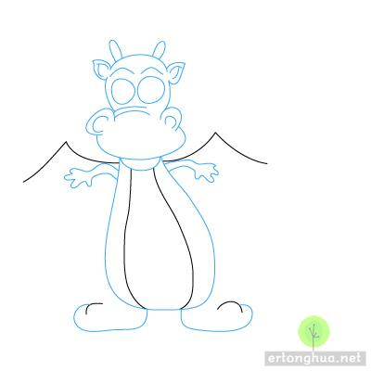
Draw a Dragon 3

Slide 11
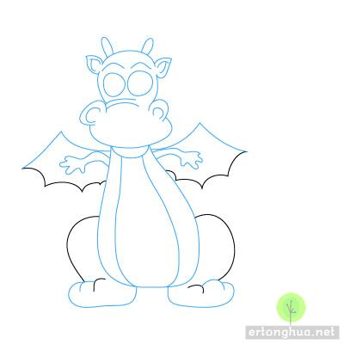
Draw a Dragon 4

Slide 12
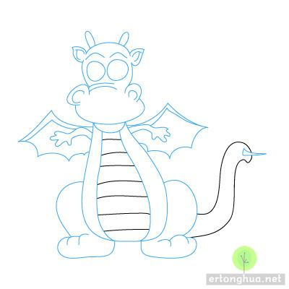
Draw a Dragon 5

