Slide 1
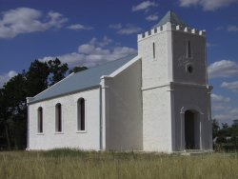
EBENEZER Mission 1859-1904 North-west Victoria (near antwerp)
By Shannon Baron

Slide 2
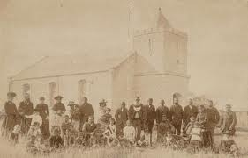
The Establishment of Ebenezer Mission
Ebenezer was first established in 1859 by the Moravian Church (which is a branch of the protestant religious community) on the banks of the Wimmera River just out of Antwerp Victoria.
Ebenezer Mission is situated on the land of the Wotjobaluk country.
The site was chosen from one of four options that were available and was recommended by the pastoralist of the Antwerp station Horatio Ellerman.
This location was chosen as it was believed that it was furtherest away from the negative effects of the settlers

Slide 3
How it was established:
Brother Hagenauer
The Moravian Church missions was the first non-Catholic missionary movement and they established missions all over the world, Ebenezer being just one of these, Lake Tyers another.
The first missionaries at Ebenezer were Brother Hagenauer and Brother Spieseke (Both who were from Germany)
Support was provided to them by Charles La Trobe a former Lieutenant-Governor of Victoria and by the Lutheran church of Victoria.

Slide 4
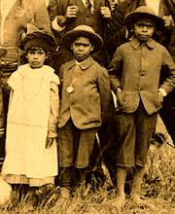
The Purpose:
The aim of the station was “to ‘civilise and Christianise’ the Aborigines of the area”(Jensz 2001)
While at the time many European settlers perceived the Indigenous Australians to be inhumane and animal like “the missionaries at Ebenezer believed that the Aboriginal people were a worthy part of humanity and had as much claim on the promises of Jesus as anyone else” (Low 2008)

Slide 5
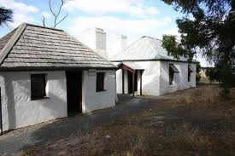
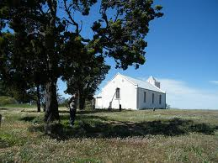
What was Ebenezer?
Ebenezer consisted of a church, kitchen, school house, store and four houses for the residents of the mission to live in.
It had a vast amount of land surrounding the main site of the mission in which the occupants could farm, hunt and go fishing.
However it was found that the soil was not the best for farming but better used for grazing

Slide 6
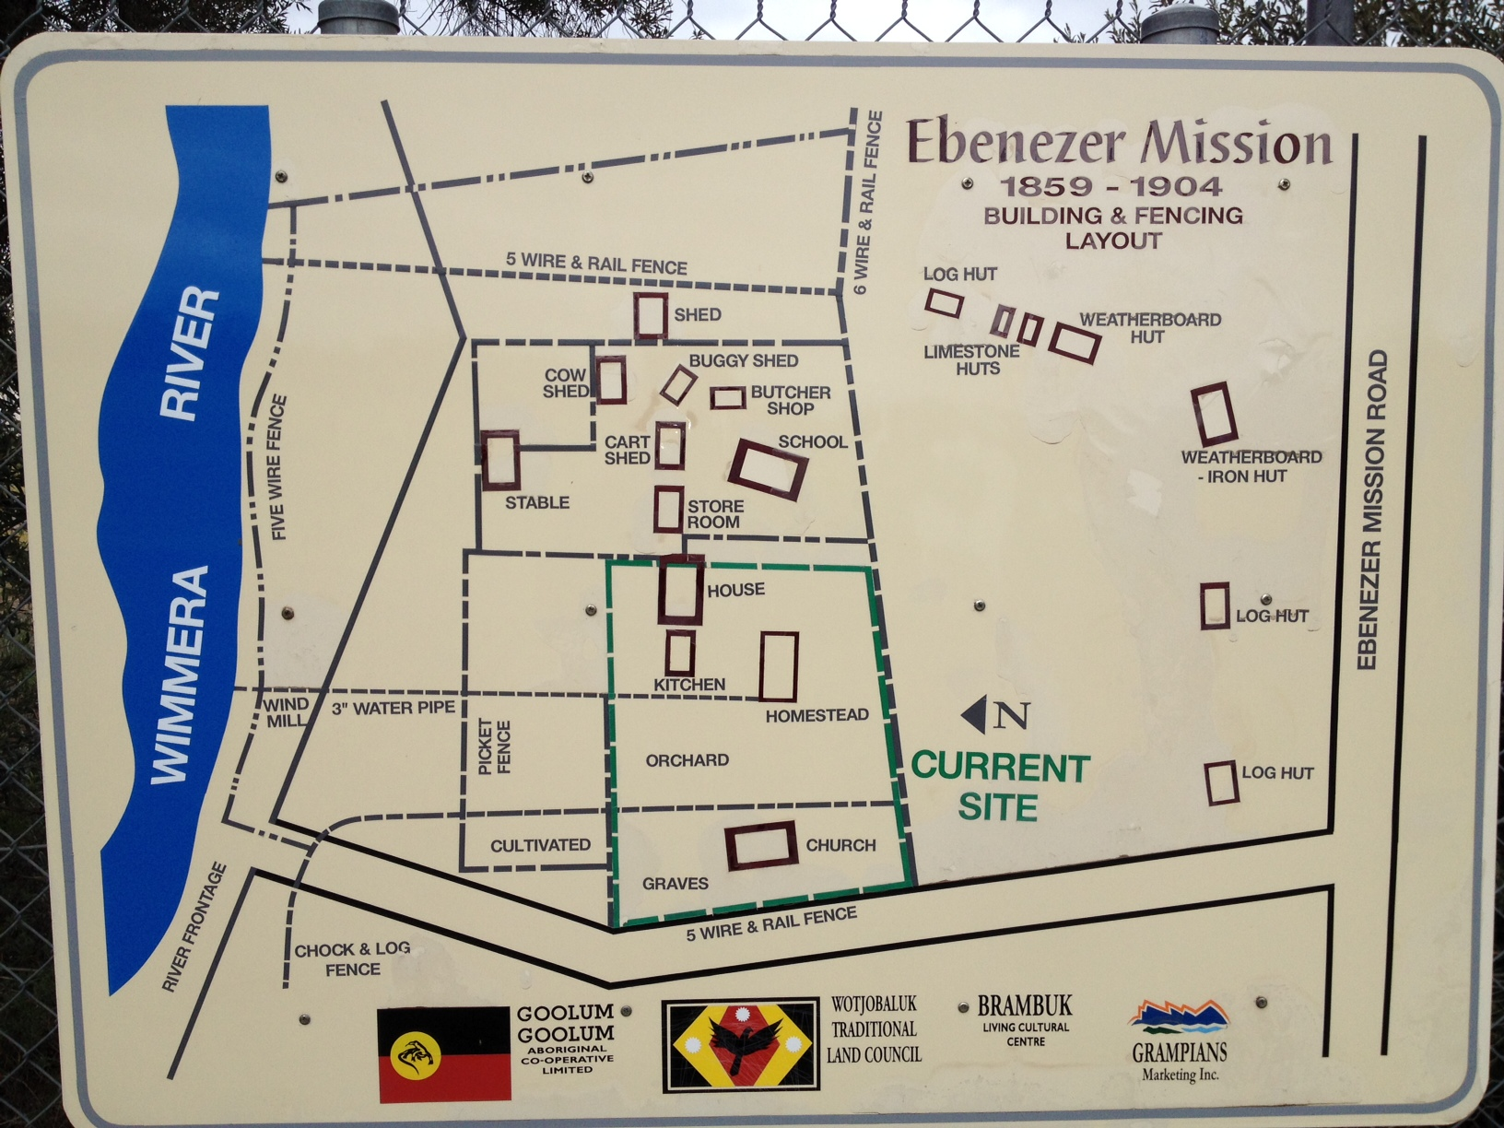

Slide 7
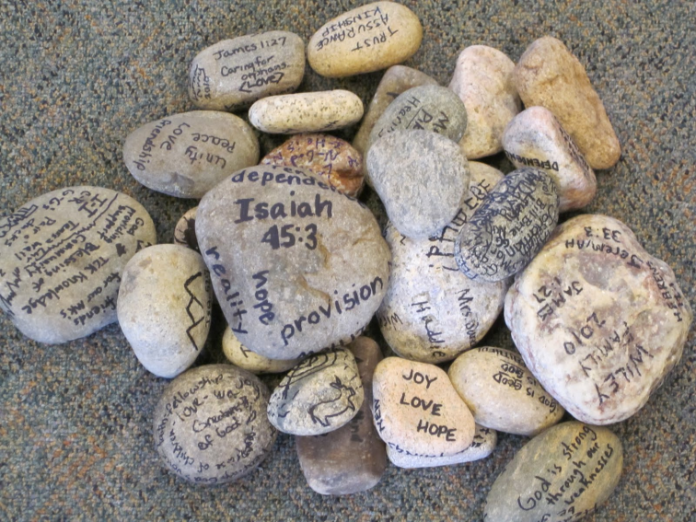
Christianity:
While English was the predominant language used at the missions, missionaries learnt the local Aboriginal language in order to teach the Aboriginals about God in a language that they could understand
Ebenezer was found to be quite a successful mission as many Indigenous Australians converted to Christianity
Ebenezer meaning “the rock of hope”

Slide 8
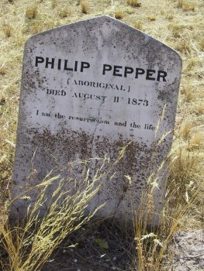
Converting:
Here is the tombstone of Philip Pepper Nathanial’s brother who was also baptised at Ebenezer
The first Aboriginal to convert to Christianity at Ebenezer was a man named Nathanial Pepper
He was baptised a year after the mission opened (this demonstrated the success of the mission)
Nathanial was the first of many Aboriginals who were baptised at Ebenezer
While a few of the Aboriginals who were buried at Ebenezer had a tombstone majority of the 150 Aboriginal people who were buried there do not.

Slide 9
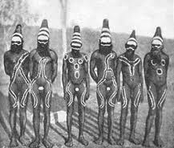
Adapting to the European way of life:
While it is thought that the Aboriginals changed their way of life straight away upon the opening of the missions this is not necessarily the case
“While the missionaries were conducting church services the local Aboriginal people continued to hold corroborees at Ebenezer” (Jensz 2001)

Slide 10
Education:
Opening a school at the mission was one of the first things that occurred as “it was through schooling that they hoped to be able to educate the Aborigines to read and also to ‘civilise’ them in European ways”
Education was seen as the key to change

Slide 11
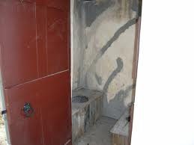
Adapting to the European way of life...
The school at Ebenezer was opened on the 17th of January 1859 (seven days after the opening of the Ebenezer mission)
On the first day it only had one student and the next day two more students joined.
The students did not attend regularly in the beginning and the school was off to a slow beginning.
However by 1901 the school had picked up and the teacher Miss Isabel Tyre taught 30 children.

Slide 12
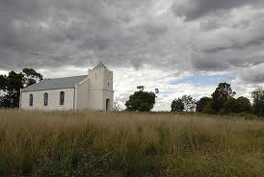
Closing of Ebenezer:
1904 Ebenezer Mission was closed due to a number of reasons including:
1. There were not many full blooded Aboriginals left in Victoria.
2. In 1886 an act of parliament ordered all mixed blooded Aboriginals under the age of 34 to vacate the stations (therefore there were not many individuals left on Ebenezer mission)
3. Three other missions were still opened in Victoria

Slide 13
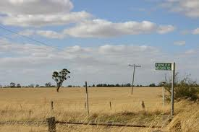
Aftermath of the closing of Ebenezer:
Some of the Aboriginals who resided at Ebenezer stayed around the area, while others were forced to move to the Lake Tyers mission
The land was handed back to the lands department in 1904 and the land of the mission excluding a small section around the buildings was divided up and sold for farming (the building still remain there today)

Slide 14
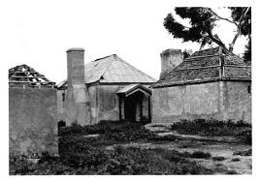
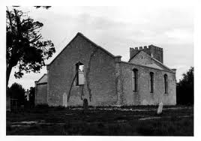
Continued....
After Ebenezer had been closed the buildings were left and neglected

Slide 15
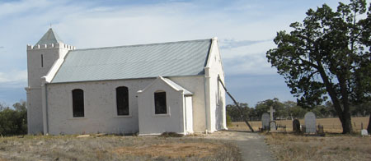
Preservation of Ebenezer:
Due to the support of Aboriginal Affairs Victoria, in the year 2000 Renovations of Ebenezer occurred
The preservation of the Ebenezer mission was celebrated by the local Koorie community (which included descendents of residents of the mission).
The renovations to Ebenezer mission helped to preserve an important Victorian historical site which is apart of the local Aboriginal history.
Preservation work is still currently occurring to other buildings and the cemetery at Ebenezer mission
Ebenezer mission church1988
Ebenezer mission church 2008

Slide 16
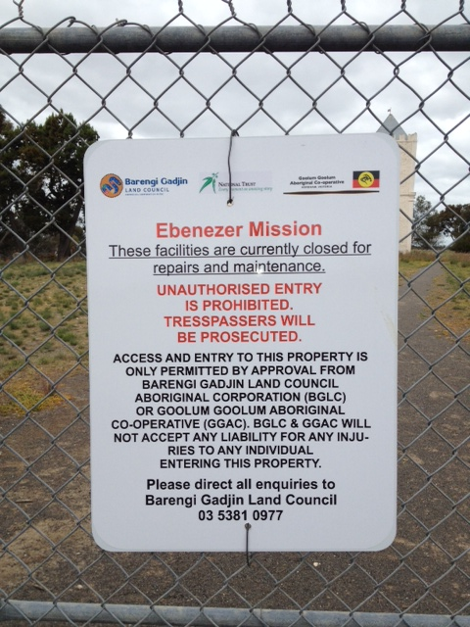
Ebenezer Today:
The National Trust and the Goolum Goolum Aboriginal Cooperative now own the Ebenezer site (however it will soon be handed over to the Barengi Gadjin Land Council)
It is currently closed for renovations
It was temporarily closed as individuals were taking tours of the site without the owners knowledge and or permission and without leaving any donations in order for the upkeep of the site

Slide 17
A greater insight to Ebenezer
R. Marks, personal communication, October 3, 2012

Slide 18
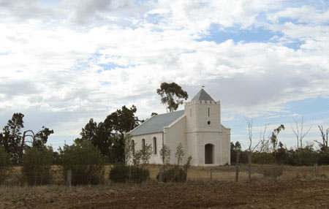
Response Towards Ebenezer:
Ray believed that both positives and negatives are associated with Ebenezer mission
Negatives:
* Some Aboriginals were forced to go on the mission, to change their religion and their way of life (Ray stated that some would have done this willingly however not all)
*The Aboriginals had to receive permission to go and see their relations/friends who were not on the mission with them
*Disease from the settlers was introduced to the Aboriginals which resulted in the deaths of many Aboriginal children on the mission
Positives:
*The Aboriginals received food rations while also being capable of hunting and fishing on the surrounding land of Ebenezer
*That the site is an important part of Aboriginal history that is still standing today
-The Aboriginal Community helped with the restoration of Ebenezer through Aboriginal Affairs Victoria

Slide 19
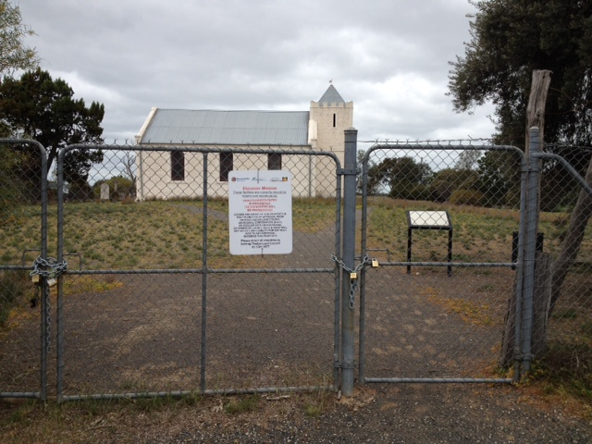
His Response to it being closed:
He believes that it is a good thing as it means:
Vandalism will not occur
Only structured tours will be conducted through the Barengi Gadjin land council (this will mean that any tourists will have to go through them first)
A greater level of information about Ebenezer will be able to be transferred to those visiting
The Barengi Gadjin land council will be able to monitor who visits Ebenezer
The site will be preserved for a longer period of time and be kept in good condition

Slide 20
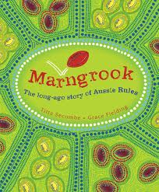
Stories about Ebenezer from Ray
Marngrook:
This is a style of AFL football played by the Aboriginals
He stated that there are photos of the Aboriginals at Ebenezer taking a bark canoe from one side of the river to the other in order to get to the football game
Weddings:
Both his niece and his partners sister were married at Ebenezer

Slide 21
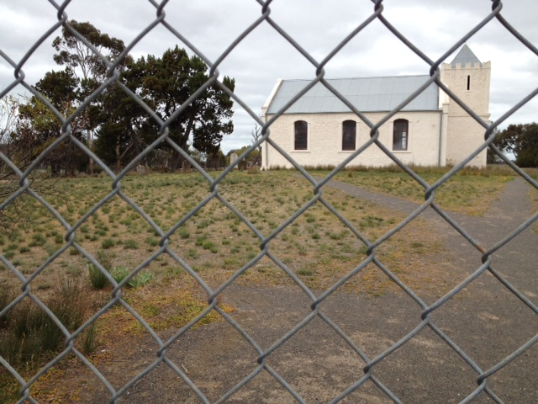
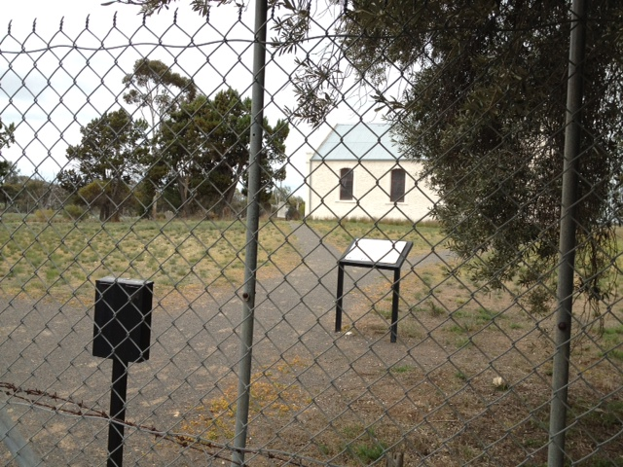
Photos from my visit to Ebenezer

Slide 22
References:
Australian Broadcasting Corporation, Film Victoria & Koorie Heritage Trust. (2004). Retrieved September 24, 2012, from http://www.abc.net.au/missionvoices/ebenezer/mission_history/default.htm
Barenji Gadjin Land Council Aboriginal Cooperation. (2011). Ebenezer mission update.Retrieved September 26, 2012, from http://www.bglc.com.au/
Jensz, F. (2001). Ebenezer mission 1859-1904. Retrieved September 24, 2012, from http://www.teachers.ash.org.au/dnutting/germanaustralia/e/ebenezer.htm
Low, J. (2008). Ebenezer: the mission on a limestone ridge. Retrieved September 24, 2012, from http://simplyaustralia.net/article-ebenezer.html
Mole, A. (2011). Ebenezer mission's slow decay. Retrieved September 24, 2012, from http://www.weeklytimesnow.com.au/article/2011/03/07/301961_national-news.html
The Australian Women’s Register. (2010). Ebenezer mission station. Retrieved September 26, 2012, from http://www.womenaustralia.info/biogs/AWE1094b.htm
The Sydney Morning Herald. (2004). Antwerp. Retrieved September 26, 2012, from http://www.smh.com.au/news/Victoria/Antwerp/2005/02/17/1108500206172.html

