Slide 1
Family Planning in China & the ‘One Child Policy’
By Shannon Baron

Slide 2
Short clip http://www.youtube.com/watch?v=R263WRIwnWo
SHORT VIDEO

Slide 3
Background
Until the cultural revolution in 1911 an increased population size was seen as an advantage
It was believed that a large population size indicated prosperity
Military power
Increase tax revenues

Slide 4
Continued…
The idea of a large population was also supported as the Soviet Union valued childbirth and large populations

Slide 5
Births per thousand population (Source: Coal, Ansley J., 1981)
Year | Urban | Rural
1954 | 42.5 | 37.5
1957 | 44.5 | 32.8
1962 | 35.9 | 37.4
1963 | 45.0 | 43.4
1964 | 33.0 | 40.3
1966 | 21.7 | 36.7
1971 | 21.9 | 31.9
1972 | 20.1 | 31.2
1973 | 18.1 | 29.4
1975 | 15.3 | 24.2
1976 | 13.6 | 20.9
1977 | 13.9 | 19.7
1978 | 14.0 | 18.8

Slide 6
Change of thought
However in the early years of communism scientists started to perceive China’s population as more of “a liability than an asset” (Scharping,2003,p.30).
Started to see a link between the large population and China’s poverty, food problems, low standards in health and education and the backwardness of the economy

Slide 7
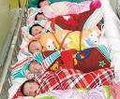
Between 1962 and 1972 China’s population peaks (300million babies born in this time)
In 1970 the average women in China had almost 6 children
Not all were financially able to support these children

Slide 8
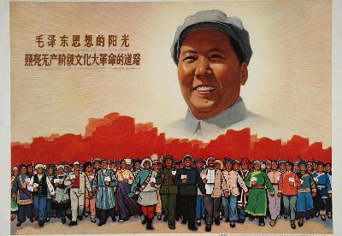
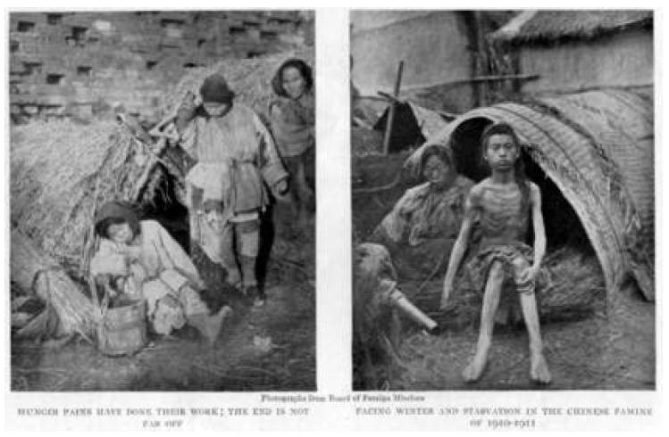
What emphasized the need for change?
The massive starvation that came about after the ‘Great Leap Forward’ was a major contributor behind the recognition that more needed to be done

Slide 9
Population Increase
It was thought that “facing poverty, ignorance and the low living standards of the masses, the country should not and (could not) encourage unconditional and universal increase of population” (Kane,1987,p.55)
“population growth was a threat to development” (Kane,1987,p.2)

Slide 10
What were the effects?
The such large population was putting strain on China economically and socially
Some of the impacts included:
*poverty
*illiteracy
*insufficient food
*lack of water resources
*air and soil pollution
*not enough housing
*unemployment
*strain on the education & health systems
*deforestation
*erosion
*increased energy consumption
*unbearable pressure on the land
*low life expectancy and high birth & death rates

Slide 11
Hong Liangzhi (1744- 1809), a Chinese scholar emphasized that “China had 60% more population than resources could comfortably support” (Kane,1987,p.53)

Slide 12
How the government dealt with the issue
In the 1950s China started its ‘government sponsored family planning program’
This included contraception and family planning services
However this was interrupted due to the great famine

Slide 13
In 1962 birth control was again put as a priority
However they did not want “birth control propaganda” (Scharping,2003,p.44) and wanted it to be kept away from the press
Wanted it to only carry on through word and mouth
At this point in time they were still strict on abortion
Only if somebody had already had four children they were allowed an abortion

Slide 14
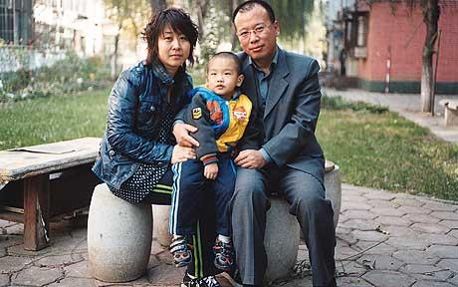
Government sponsored family planning program started again in 1970
Between 1970 and 1978 the population control campaign intensified
This was when the ‘later (births), longer (intervals), fewer (children)’ campaign was introduced
In 1975 a maximum recommended family size was introduced (2 children in cities, 3-4 in rural areas)

Slide 15
“Later, Longer, Fewer” campaign
This campaign encouraged late marriages (23-25 for women and 25-28 for men)
An extra clothing ration was given to those who married after the age of 30
This also encouraged people to have children later
Suggested birth spacing of 4 or 5 years between children
Incentives were given to those who had one child and discouragements were given to those with more than 3
(eg those having their 4th child didn’t receive a cotton coupons, those with one child has provision of child health care fees and maternity leave)

Slide 16
This is when the slogan:
“one is good, two is alright, three is too many” (Kane, 1987,p.79)
was introduced

Slide 17
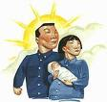
‘The one child policy’
In 1979 the ‘one child policy’ was introduced
It was seen as “essential to economic reform and to an improvement in living standards” (Hesketh, Lu, & Wei Xing,2005).
The policy implementation varied through region
* while the policy was called the ‘one child policy’ exceptions were made

Slide 18
Exceptions:
if the first child was born with a disability
if both parents worked in a high risk job(such as mining)
In rural areas they were sometimes allowed to have a second child 5 years after their first if they had a daughter
While there were exceptions to the policy they were quite strict on individuals who lived in urban areas and those who were employed by the government

Slide 19
What actually occurred?
Birth permits were made necessary (even before individuals conceive a child)
Sterilization occurred to individuals who had already had children
Pregnant women who didn’t have birth permits were handcuffed and made to have abortions
Fines and confiscation of belongings occurred
People who went against the policy were dismissed from work
Often the benefits to individuals who had only one child were not received
The goal was for China to have a growth rate of 1.3 by the year 2000

Slide 20
Discussion….
What would you say if you were told you could only have one child?

Slide 21
Opinions on the policy
The policy was more accepted by individuals in urban areas rather than those in the rural areas
This was as:
Individuals in urban areas often lived busy lifestyles
Urban living areas were a lot smaller
Those in rural areas often relied on sons for manual labour (also more children more assistance)
*Some individuals (both rural and urban dwellers) simply had the desire for more children

Slide 22
Effects
Individuals are more likely to have their babies at home without the required medical assistance
Deliberate misinterpreting of the statistics
Discrimination against females occurred
Sex-selected abortions, adoptions or abandonment
The rich often had more children as they could afford to pay the compensation fee
There was corruption of the officials
It was not practical to have only one child as there was not sufficient amounts of contraception available

Slide 23
Relaxation of the policy
In 1984 the one child policy was relaxed considerably:
Second child permits were given more often
If both spouses were an only child then they were permitted to have two children
*This relaxation of the policy was needed as there was great tension between the government and civilians

Slide 24
The impact of the ‘one child policy’
High sex-ratio (for every 100 females there are 119 males)
Means that not all men can get married and have children
There is an increase in kidnapping and trafficking of women
An increase in sex workers (therefore an increase in STIs)
High abortion rates/sex-selective abortions occur
Manipulation of statistical data
An accelerated aging process
The ratio between adult children and dependent elderly parents
Psychological damage from having to give up children or not being able to have the desired amount

Slide 25
Activty….
Write down a list of pros and cons to the ‘one child policy’

Slide 26
Conclusion
China’s one child policy is still going today however to a much more relaxed extent with more considerations!!!
While something needed to be done to decrease the pressure on China’s resources it is debated whether or not the ‘one child policy’ was the way to go about it!

Slide 27
QUESTIONS????

Slide 28
REFERENCES:
China-profile timeline: chronology of key events.(2011). Retrieved from http://www.china-profile.com/history/hist_list_1.htm 20/08/11
Hesketh, T., Lu, L. & Wei Xing. (2005). The effect of China’s one-child family policy after 25 years. Retrieved from www.nejm.org/doi/full/10.1056/NEJMhpr051833 28/08/11
Kane, P. (1999). China’s one child family policy. Retrieved from www.ncbi.nlm.nih.gov/pmc/articles/PMC1116810 25/08/11
Kane, P. (1987). The second billion-population and family planning in China. Ringwood, Australia: Penguin Books
Chen, L. (2008). Gender and Chinese development towards an equitable society. Abingdon, Oxon: Routledge
One-child policy in China. Retrieved from http://factsanddetails.com/china.php?itemid=128&catid=4&subcatid=15 25/08/11
Scharping, T. (2003). Birth control in China 1949-2000 population policy and demographic development. Abingdon, Oxon: Routledge
Zhao, Z., & F, Guo. (Ed.).(2007).Transition and challenge China’s population at the beginning of the 21st century. Oxford, New York: Oxford University Press

